Slide 1


Kayla Humphries
August 29, 2022

Slide 2

Outline
Executive Summary
Introduction
Methodology
Results
Conclusion
Appendix

Slide 3
Executive Summary
Summary of methodologies
Data Collection via API
Data Collection via Web Scraping
Data Wrangling
Exploratory Data Analysis via Structured Query Language (SQL)
Data Visualization with Folium and Dashboard (Plotly Dash)
Machine Learning Predictive Analysis
Summary of all results
Exploratory Results
Visual Analytics Results via Dashboard
Predictive Analysis Results

Slide 4
Introduction
Project background and context
Space Y that would like to compete with SpaceX founded by Billionaire industrialist Allon Musk. Therefore, we need to determine the price of each launch and if SpaceX should reuse the first stage. Instead of using rocket science, we will use a machine learning model and public historical information in order to predict if SpaceX will reuse the first stage.
Problems you want to find answers
Components within a successful launch.
Correlation of factors that contribute to a successful launch.

Slide 5

Section 1

Slide 6
Methodology
Executive Summary
Data collection methodology:
API to SpaceX dataset
Screen scrape of SpaceX informational website.
Perform data wrangling
Analysis of missing data.
Analysis of data types.
Calculation of launch outcomes.
Perform exploratory data analysis (EDA) using visualization and SQL
Perform interactive visual analytics using Folium and Plotly Dash
Perform predictive analysis using classification models
Log Regression
Decision Tree
SVM
KNN

Slide 7
Data Collection
Data was extracted from external Spacex datasets and website via API and screen scrape (BeautifulSoup) technologies. Then, data was transformed into Python dataframes for data analysis and transformation. Once the data was converted to useable dataframes, then the data was normalized and reviewed for data types analysis and missing data.
High-level Data Flowchart for ETL Process (focus on Extraction and Transform)
Extraction
API
Screen Scrape
Transform
Dataframe
Missing Elements and Data Type Analysis
Load

Slide 8
Data Collection – SpaceX API
Present your data collection with SpaceX REST calls using key phrases and flowcharts
GitHub URL of the completed SpaceX API calls notebook: My_Repository/Capstone Data Collection API.py at main · kyounghumphries/My_Repository (github.com)
Access URL
getBoosterVersion(data)
getLaunchSite(data)
getPayloadData(data)
getCoreData(data)

Slide 9
Data Collection - Scraping
First, we access the SpaceX Wiki page via the URL. Next, we perform the screen scrape via Beautiful Soup. Once the HTML content has been extracted, we parse the data and obtain column and variable names. Last, we use the parsed data to create a usable dataframe.
GitHub URL of the completed web scraping notebook: My_Repository/Capstone Web Scraping.py at main · kyounghumphries/My_Repository (github.com)
Access Spacex Wiki Page URL
Obtain Column and Variable Names
Dataframe Creation

Slide 10
Data Wrangling
For the data wrangling process, we first accessed the dataframe and reviewed missing content and data types. Then, we performed calculations on launches and orbits. Last, performed calculations to determine landing outcome based upon the dataframe.
GitHub URL: My_Repository/Capstone Data Wrangling.py at main · kyounghumphries/My_Repository (github.com)
Access data and create dataframe
Review missing content and data types.
Calculate launches and orbits.
Determine landing outcome.

Slide 11
EDA with Data Visualization
For initial analysis, the scatter plot was used since it provides an overview of correlation and activity. Then, the bar and line charts were used to drill down within the details of the numeric values.
GitHub URL: My_Repository/EDA With Visualization.py at main · kyounghumphries/My_Repository (github.com)

Slide 12
EDA with SQL
SQL Queries
Select statement to display unique launch sites.
Select statement to display CCA launch sites.
Select + sum statement to display payload mass of boosters from NASA.
Select + average statement to display average payload mass of F9 v1.1 booster.
Select + date to display successful landing outcomes.
Select statement to determine successful drone ship with mass >4000, <6000.
Select + counter for total success and failures.
Nested select +max for maximum payload mass.
Select statement to determined failed drone ship outcomes.
Select + count to determine total success and failures for drone ship and ground pad.
GitHub: My_Repository/Capstone SQL Python.py at main · kyounghumphries/My_Repository (github.com)

Slide 13
Build an Interactive Map with Folium
To identify launch sites, markers and blue circles were added to map objects created via Folium. Further, these markers were used to identify specific locations (using lat and long specifications). Then, successful and failed launches were marked on the map, and distances between launch sites were calculated and visualized on the map.
These objects were used in order to determine preliminary correlation between laun sites.
GitHub URL: My_Repository/Visual Analytics with Folium lab.py at main · kyounghumphries/My_Repository (github.com)

Slide 14
Build a Dashboard with Plotly Dash
The dashboard includes a pie chart and scatter chart for SpaceX launch records presentation.
The pie chart and scatter chart was used in order to allow the user to perform high level interactive analysis on the SpaceX launch records.
GitHub URL:My_Repository/spacex_dash_app.py at main · kyounghumphries/My_Repository (github.com)

Slide 15
Predictive Analysis (Classification)
Logistics regression, support vector machine, decision tree, and KNN models were created for predictive analysis. Further the score method was used against each model to rate accuracy. In addition, the confusion matrix was used against each model for prediction visualization.
GitHub URL: My_Repository/Machine Learning Prediction.py at main · kyounghumphries/My_Repository (github.com)
Logistics regression
SVM
Decision Tree
KNN
Score Method for Accuracy
Confusion Matrix for Prediction Visualization

Slide 16
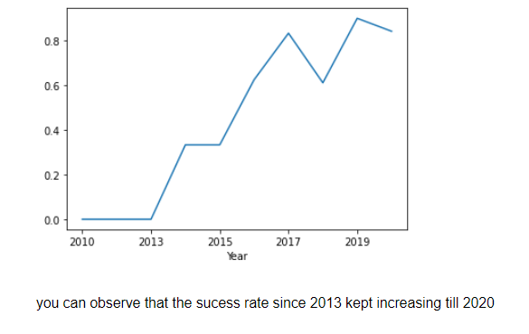
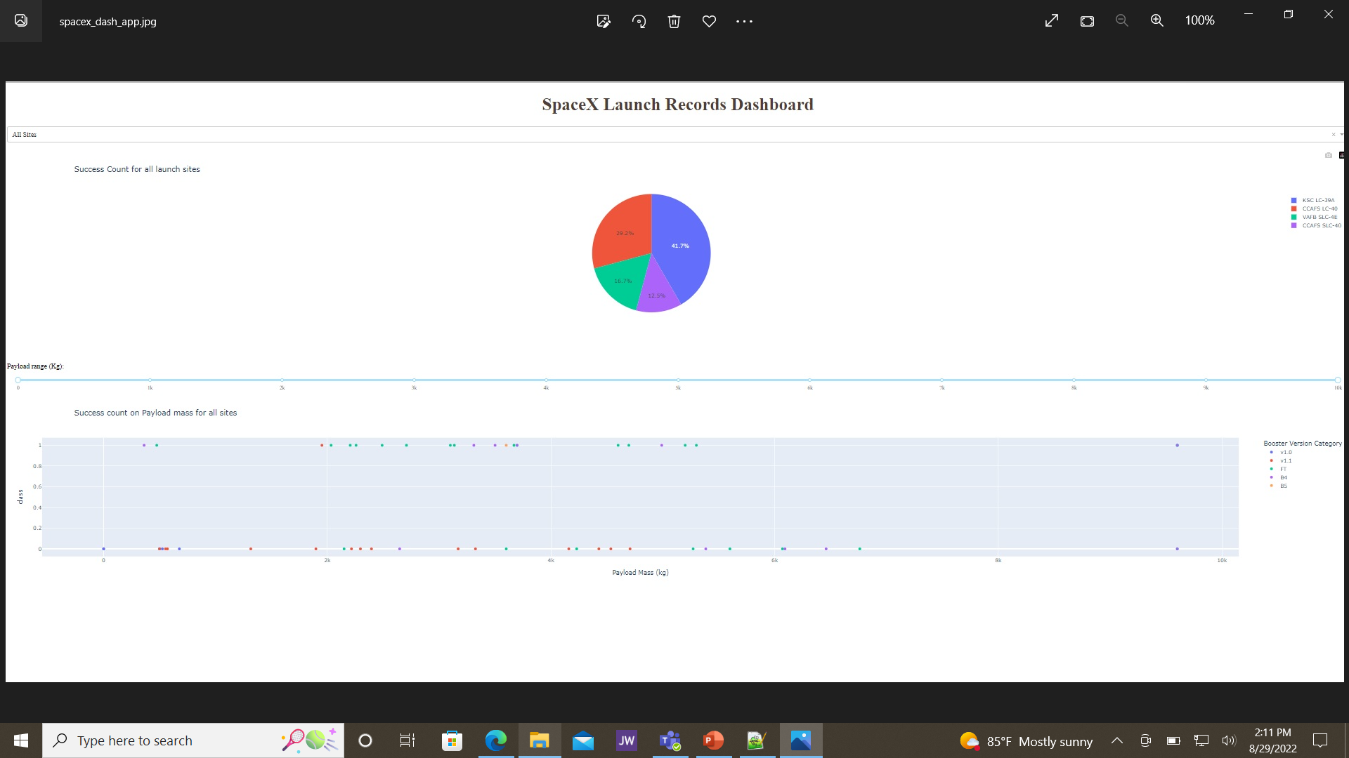
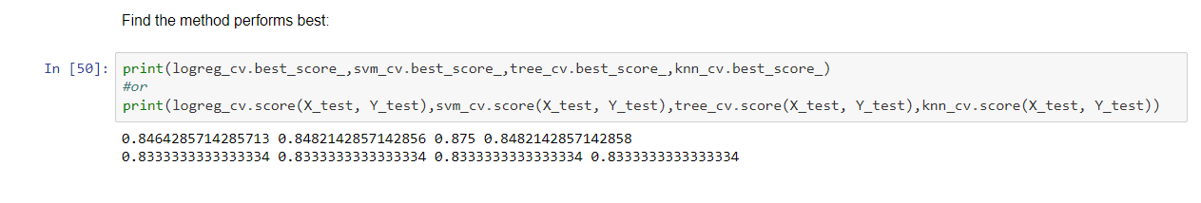
Results
Exploratory data analysis results
Interactive analytics demo in screenshots
Predictive analysis results

Slide 17

Section 2

Slide 18
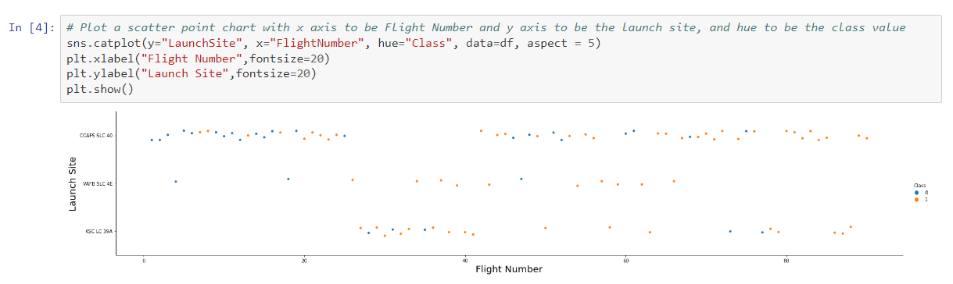
Flight Number vs. Launch Site
Scatter plot of Flight Number vs. Launch Site
Scatter plot with explanations: SLC4E presents a strong relationship between the launch site and flight number. The success is related to the flight number.

Slide 19
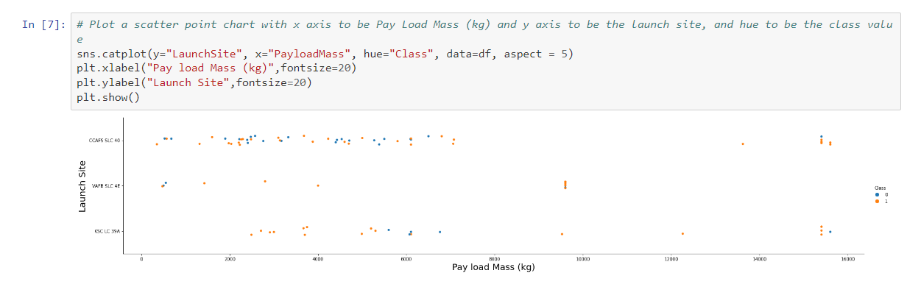
Payload vs. Launch Site
Scatter plot of Payload vs. Launch Site
Scatter plot with explanations: SLC 4E presents the stronger relationship between pay load mass and launch site. SLC 40 appears to have the weakest relationship between the two factors. The success of SLC4E is related to the pay load mass.

Slide 20
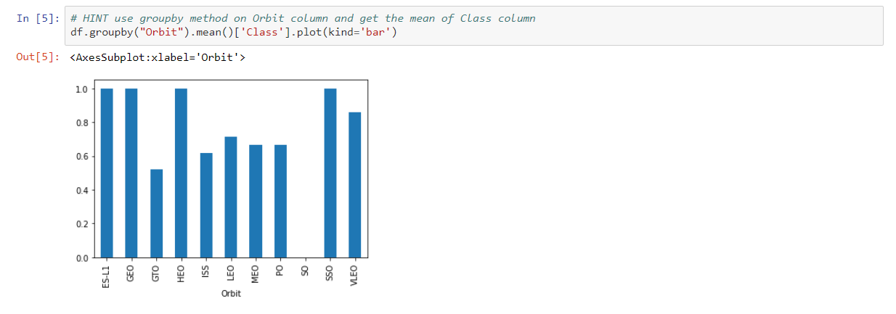
Success Rate vs. Orbit Type
Bar chart for the success rate of each orbit type
Explanations: ES-L1,GEO, HEO, and Sso have higher success rates. GTO presents the lowest success rate of captured data.

Slide 21
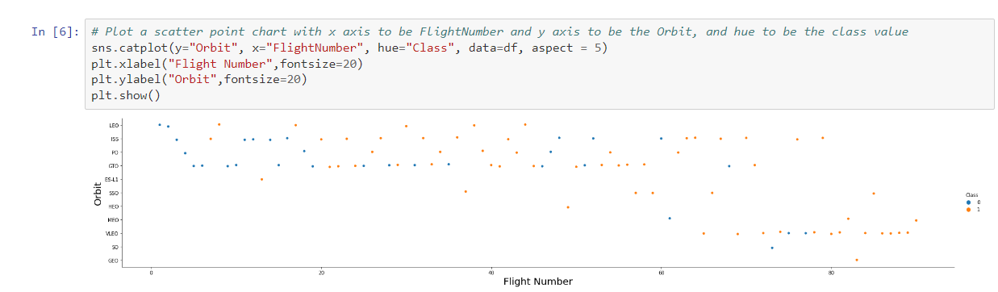
Flight Number vs. Orbit Type
Show a scatter point of Flight number vs. Orbit type
Explanation: For LEO, the success of the orbit is related to the flight number.

Slide 22
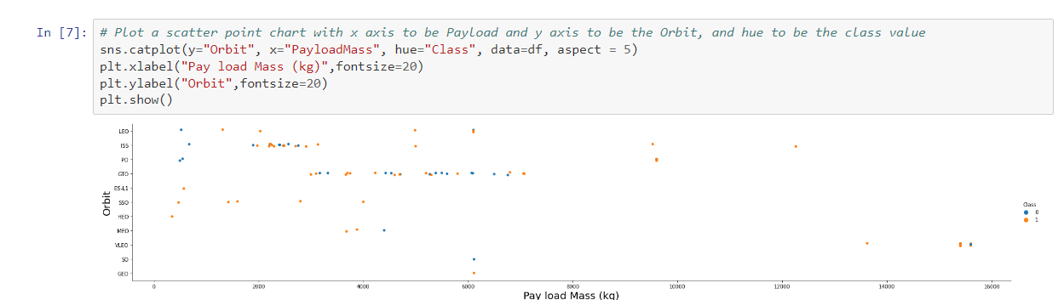
Payload vs. Orbit Type
Scatter point of payload vs. orbit type
Explanation: Polar,LEO and ISS all present more positive landings.

Slide 23
Launch Success Yearly Trend
Line chart of yearly average success rate
Explanations: The success rate increases starting in 2013.

Slide 24
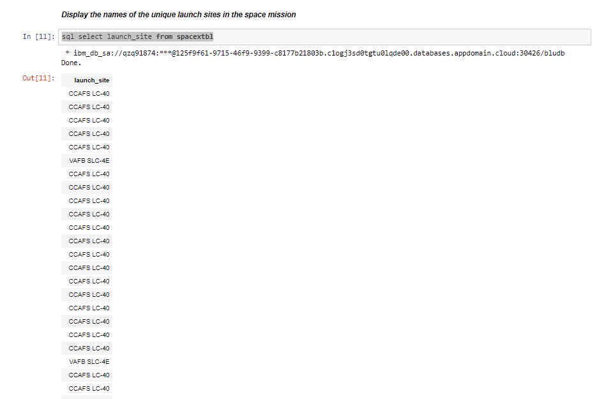
sql select launch_site from spacextbl
All Launch Site Names
Unique launch sites
Explanation: It appear the launch site with the largest amount of launches is CCAFS LC-40.

Slide 25
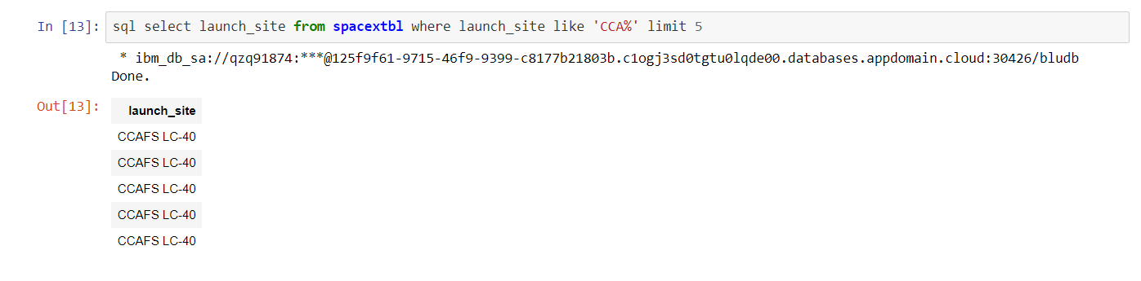
Launch Site Names Begin with 'CCA'
Find 5 records where launch sites begin with `CCA`
Explanation: The first five rows belong to launch sites beginning with ‘CCA.’

Slide 26
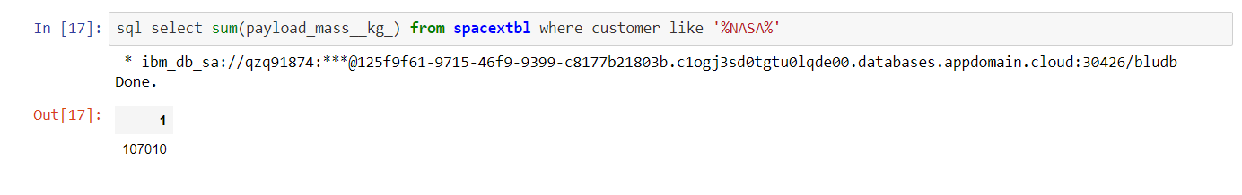
Total Payload Mass
Calculate the total payload carried by boosters from NASA
Explanation: NASA has a total payload mass of 107010.

Slide 27
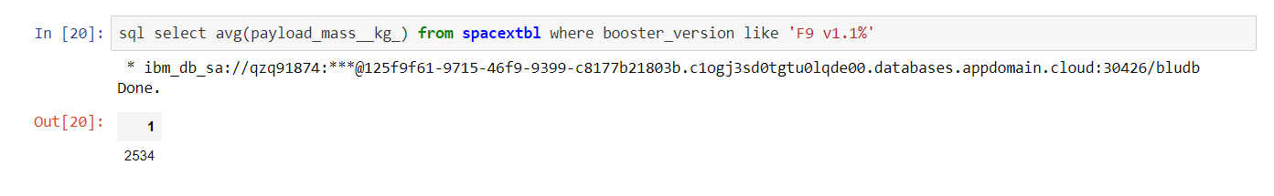
Average Payload Mass by F9 v1.1
Calculate the average payload mass carried by booster version F9 v1.1
Explanation: Average payload mass for F9 v1.1 booster is 2534.

Slide 28
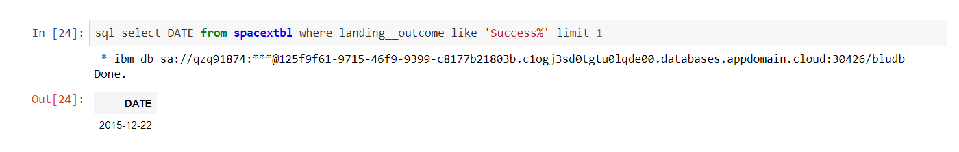
First Successful Ground Landing Date
Date of the first successful landing outcome on ground pad
Explanation: The first successful landing was 12-22-2015.

Slide 29
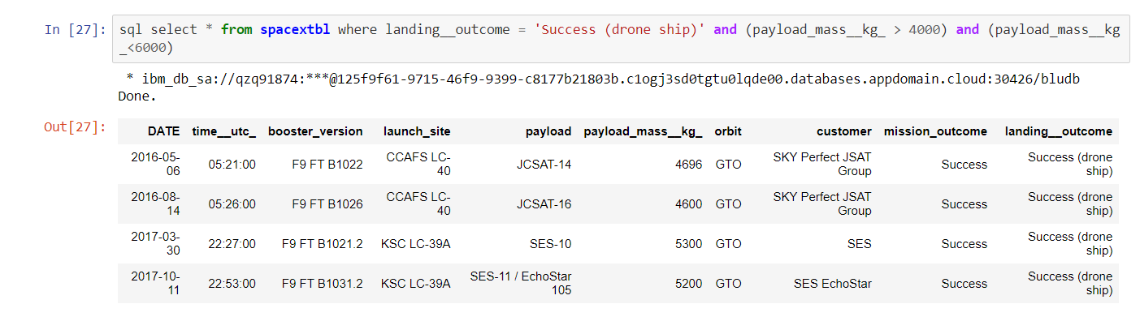
Successful Drone Ship Landing with Payload between 4000 and 6000
List the names of boosters which have successfully landed on drone ship and had payload mass greater than 4000 but less than 6000
Explanation: The screen print illustrates the four boosters produced from this query.

Slide 30
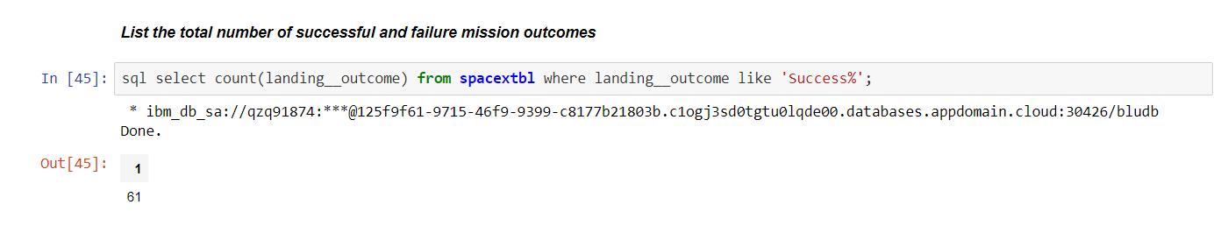
Total Number of Successful and Failure Mission Outcomes
Calculate the total number of successful and failure mission outcomes
Explanation: There are 61 success outcomes.

Slide 31
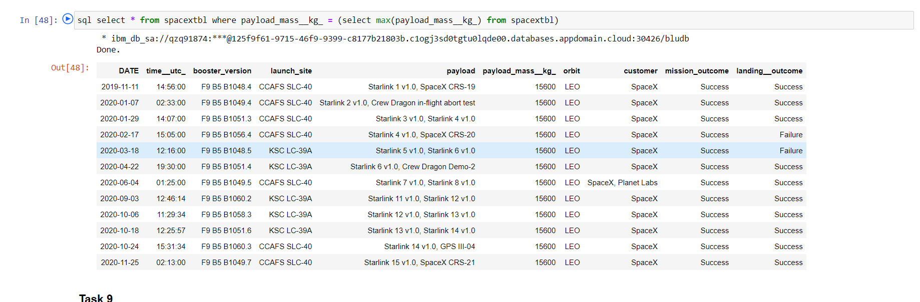
Boosters Carried Maximum Payload
List the names of the booster which have carried the maximum payload mass
Explanation: LEO has the maximum payload mass.

Slide 32
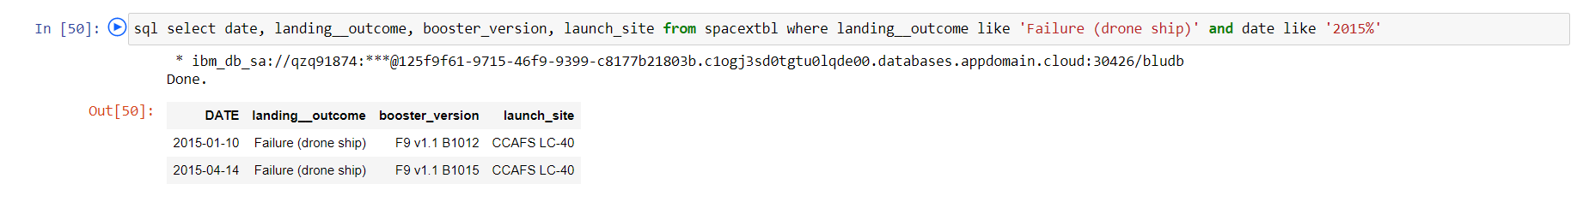
2015 Launch Records
List the failed landing_outcomes in drone ship, their booster versions, and launch site names for in year 2015
Explanation: Boosters F9 v1.1 B1012 and 1015 had failures on 01/10/2015 and 05/14/2015.

Slide 33
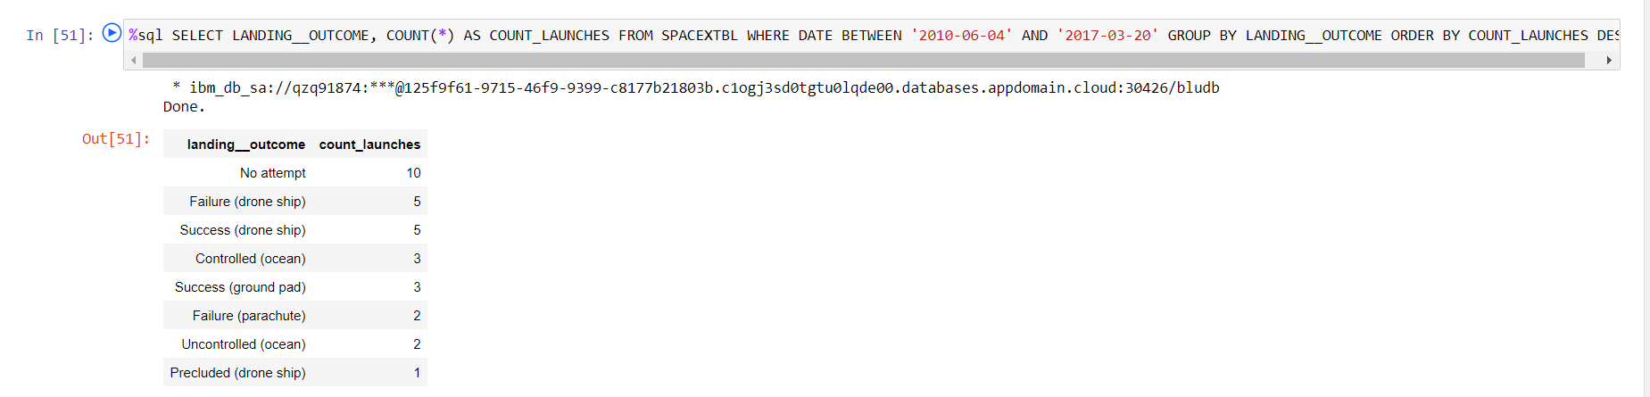
Rank Landing Outcomes Between 2010-06-04 and 2017-03-20
Rank the count of landing outcomes (such as Failure (drone ship) or Success (ground pad)) between the date 2010-06-04 and 2017-03-20, in descending order
Explanation: The highest landing outcome is “no attempt” with a count launch of 10. The lowest landing outcome is precluded (drone ship).

Slide 34

Section 3

Slide 35
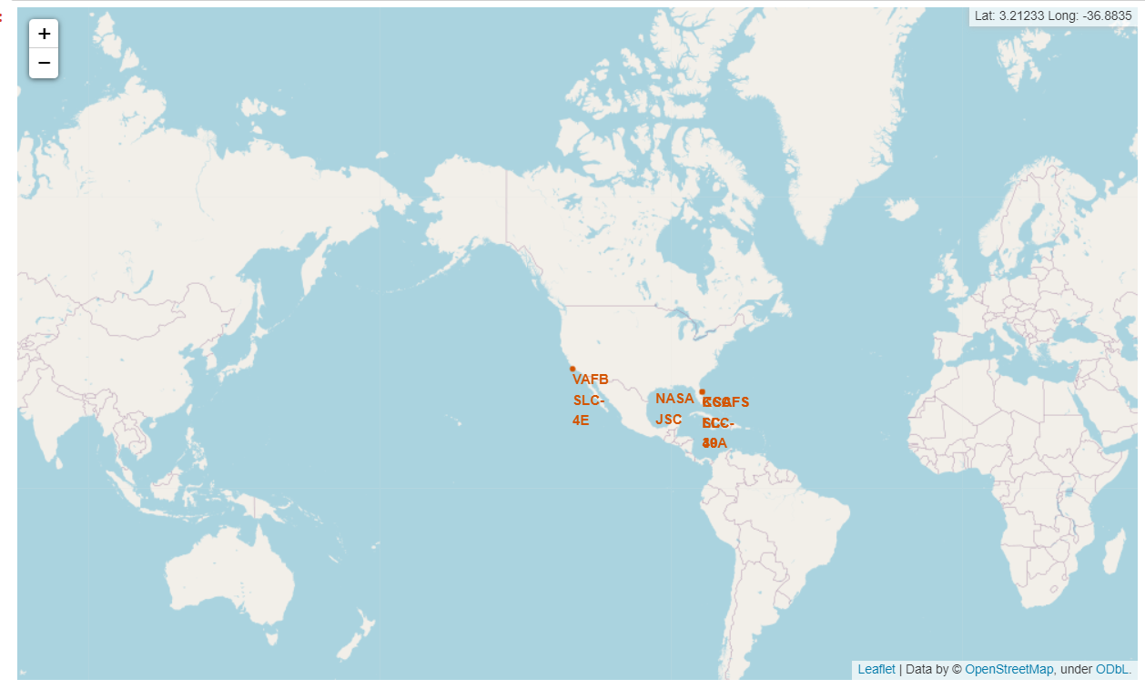
Global Map of Testing Sites
Explanation: All testing sites are located within the United States of America. Most test sites are located within the state of Florida – close to the ocean.

Slide 36
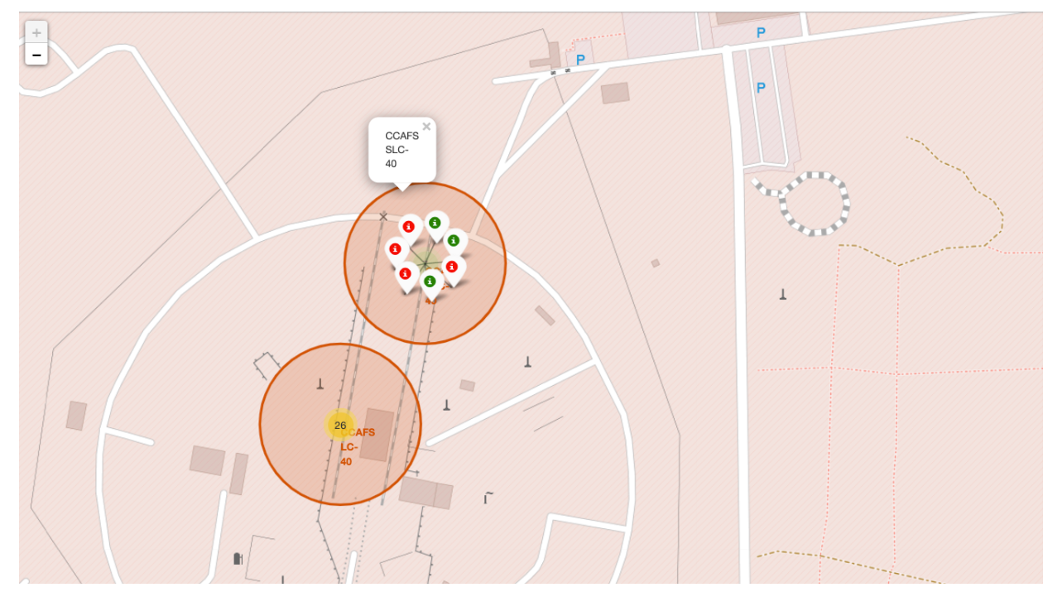
Map of Sites With Success Rates
Explanation: This map shows the sites with the highest success rates.

Slide 37
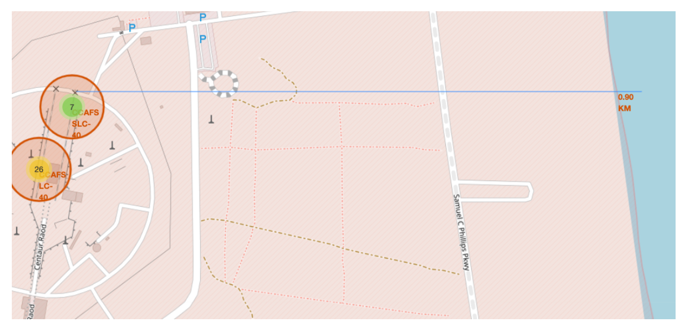
Folium Map With Railway, Highway, Coastline
Explanation: Seven sites are within 0.90 KM from the ocean border.

Slide 38

Section 4

Slide 39
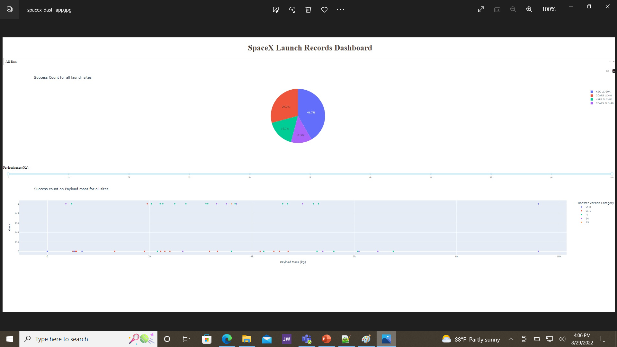
Dashboard Pie Chart – All Sites
Explanation: KSC LC-39A has the largest success count per the pie chart illustration.

Slide 40
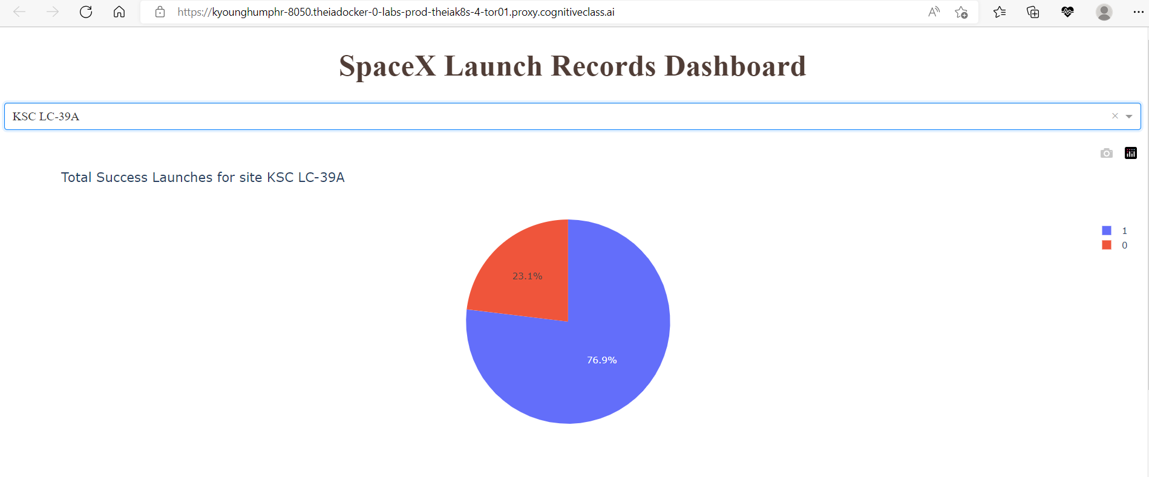
Total Success Launches for KSC LC-39A
Explanation: Total success launches for KSC LC-39A is 76.9%.

Slide 41
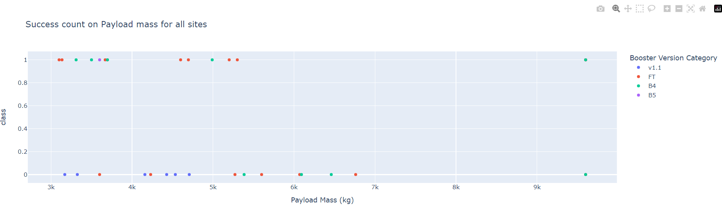
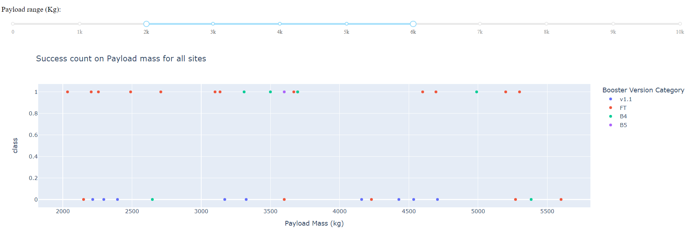
Scatter Plot Payload Mass for All Sites
Explanation: payload mass at 3k – 10k
Explanation: payload mass at 2k – 6k

Slide 42

Section 5

Slide 43
Classification Accuracy
Explanation: Model 3 (Decision Tree) presented the highest accuracy.

Slide 44
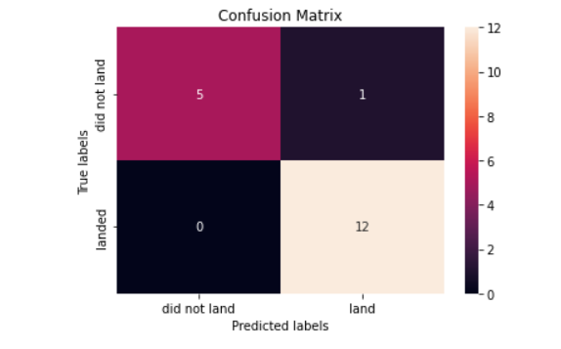
Confusion Matrix
Decision tree can distinguish between the different classes, but there is a problem with false positives.

Slide 45
Conclusions
KSC LC 39A had the highest success rate in launches.
ES-L1,GEO, HEO, and Sso have higher success rates. GTO presents the lowest success rate of captured data. Point 3
Polar,LEO and ISS orbits all present more positive landings.
Success rates have been increasing since 2013, and the projection is success rates will continue to increase.

Slide 46
Appendix
Include any relevant assets like Python code snippets, SQL queries, charts, Notebook outputs, or data sets that you may have created during this project

Slide 47


